Slide 1


Maven – How it works?
Maven Local Repository
(Your Computer)
Check local Repo
Project Config file (pom.xml)
2
Spring
Hibernate
JSON
…
…
Read Config file
1
4
Maven
Save in local Repo
5
Build and Run
Maven Central Repository(Remote)
3
Get from Remote Repo

Slide 2
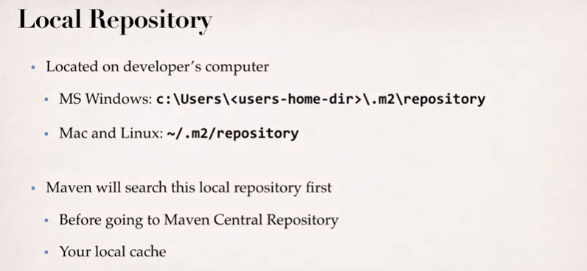
Maven – How it works?

Slide 3
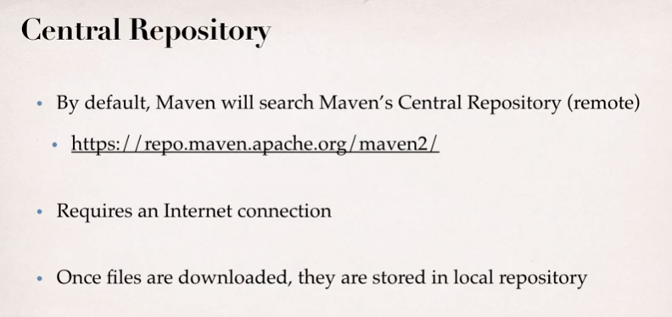
Maven – How it works?

